Slide 1

Document ID
Version: 1.0
Standard Operating Procedure for Order to Cash Policy
Date of creation: 2024 April 03
Farzana
PARTICULARS
Scope
Responsibilities
Procedure
Flowchart

Slide 2
Purpose
The purpose of this standard operating procedure (SOP) on Order to Cash (O2C) policy is to establish clear guidelines and procedures for the entire order fulfillment cycle. It aims to streamline workflows, enhance efficiency, accuracy, and customer satisfaction, optimize cash flow, ensure compliance with regulations, and maintain proper cash control throughout the process.
Scope
The scope of this SOP covers all activities and processes involved in the Order to Cash cycle, starting from Order Processing to collection and proper recording. It encompasses Order Entry, Order Processing, Order Fulfillment, Invoicing, Credit Management, Collections, Cash Application, Reporting and Analysis, and Customer Communication.

Slide 3
Responsibilities
Management
Oversight of the entire O2C process, approval of SOP, allocation of resources..
Trainers
Conducting training sessions to ensure understanding and implementation of SOP..
Data Specialists
Data analysis, monitoring performance, generating reports
Reviewers & approvers
Thorough examination and validation of SOP.
.
4

Slide 4
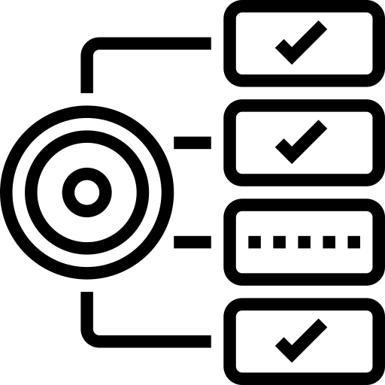

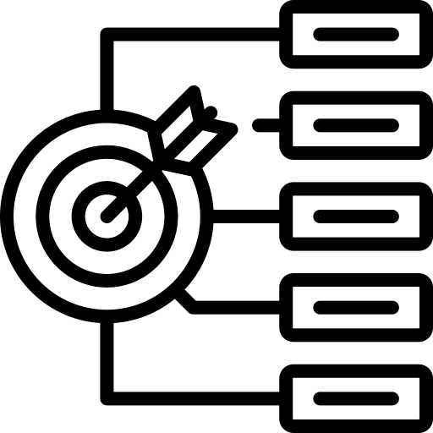


Requirements
Thorough understanding of existing O2C processes.
Process mapping with detailed documentation.
Review and approval process with relevant stakeholders.
Training and development plan for team members.
Implementation of monitoring and reporting system based on defined KPIs.

Slide 5
Procedure for Order to Cash Policy
Defining objectives and Scopes
Clearly outline the objectives of the SOP which could be efficiency, accuracy, cash flow optimization, customer satisfaction, compliances, cash control etc.
Specify the scope of the SOP by identifying the processes and activities it will cover within the Order to Cash cycle which starts with Order Processing and ends with collection and proper recording.
2. Understanding existing process
Identifying and conduct stakeholder interviews
Process Mapping with detailed documentation of each step in O2C Process
Timeline analysis
Data collection and analysis
Feedback and Pain Points
3. Document Process Steps
Order Entry
Order Processing
Order Fulfillment
Invoicing
Credit management
Collections
Cash application
Reporting and Analysis
Customer Communication

Slide 6
4. Review and Approval Process
Identify Reviewers and Approvers and establishing review timelines
Distribute the SOP for Review and collect feedback
Compile and analyze feedback and do revision and clarification
Second Review (if necessary)
Authorization and implementation
5. Training and Development
Making people know the importance of Order to cash policy and how this would help them
Implement the SOP and monitor its effectiveness over time
6. Monitoring and Reporting
Implement a system for monitoring the performance of the O2C process based on the defined KPIs. Generate regular reports to assess efficiency and identify areas for improvement.

Slide 7
General Instructions
Communicate the importance of the O2C policy to all stakeholders.
Ensure thorough documentation of existing processes.
Seek feedback from all relevant departments and personnel.
Collaborate closely with IT for system integration and data management.
Provide comprehensive training to all team members.
Regularly monitor performance metrics and adjust processes accordingly.
8

Slide 8
General Challenges
Resistance to change from stakeholders.
Lack of documentation or outdated processes.
Data inconsistency or inaccuracies.
Integration issues between different systems or departments.
Ensuring compliance with regulatory requirements.
8

Slide 9
Process Implementation Checklist
Do’s | Don’ts
Do clearly outline objectives and scope to ensure alignment and consistency. | Don't overlook stakeholder input and feedback during the SOP development process.
Do conduct thorough analysis of existing processes to identify improvement opportunities. | Don't implement the SOP without proper review and approval from management and relevant stakeholders.
Do document each step of the O2C cycle with detailed responsibilities, inputs, and outputs. | Don't ignore performance monitoring and reporting, as it is essential for identifying areas for improvement.
Do regularly monitor performance metrics and generate reports for continuous improvement. | Don't deviate from SOP guidelines without proper authorization and documentation.
8

Slide 10
Inputs

Slide 11
Link to Sample

Slide 12
Revision History
Archives
Appendix

Slide 13
THANKYOU

